Slide 1
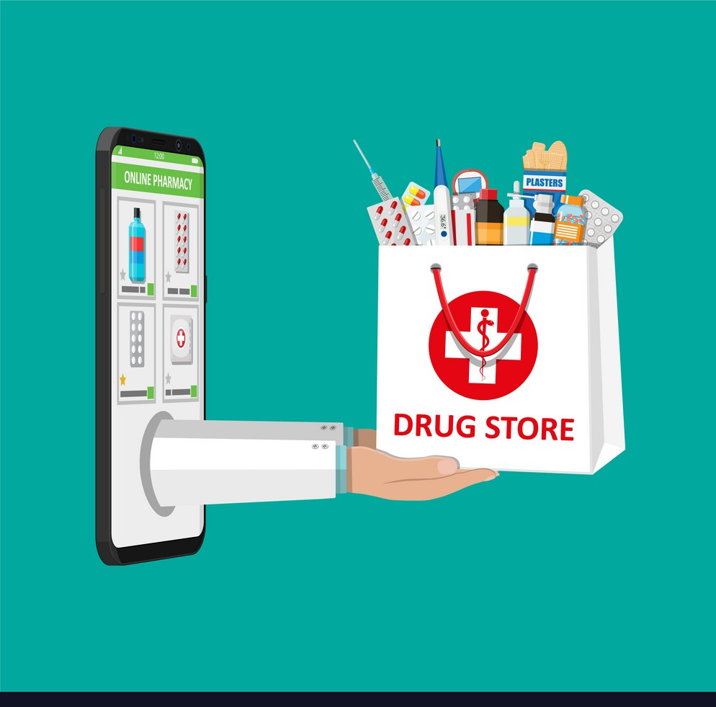
VCare Medical & Financial services
Rahul Sridharan
Mohit Shimpi
Mohit Negi

Slide 2
Address in-accessibility of life-saving medicines during Covid-19 pandemic due to lockdowns
Address financial in-stability faced by Delivery partners due to delay in payroll process
Problem Statement :

Slide 3
Provide robust network of rapid medicine delivery
Provide advanced financial credit to Delivery partners for completing their order
Solution Proposed :

Slide 4
During the beginning of Covid-19 pandemic, many countries had imposed complete lockdown and every public transportation system was halted.
This caused total inconvenience to people who were dependent on public transit. Many suffered to get essentials such as food and medicines.
Now with the second and third waves in pursuit, many countries have started to implement complete lockdowns again.
Background :

Slide 5
In order to save humanity from going through the same plight, we have developed an application which would deliver medicines to the doorstep of people. This would reduce the risk of contracting the deadly virus.
In addition to the impact on health, people have faced financial crisis due to loss of jobs.
In order to support our front-line warriors who have bravely accepted to deliver medicines to the needy, we have collaborated with multiple financial institutions to provide salary as advanced credit to the delivery people.

Slide 6

The Delivery person can use this advanced credit for personal expenses and deliver orders equivalent to the value
Once the credit is expired, they can request for more and continue with their delivery.
This option is very welcoming amongst our delivery partners and has become a viable option for survival during these hard times.

Slide 7
DESIGN

Slide 8
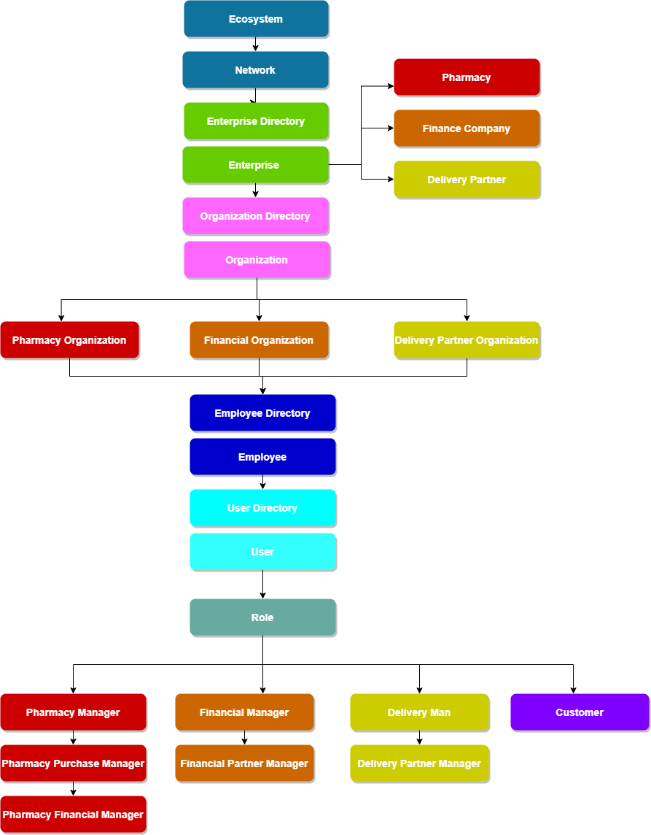

Slide 9
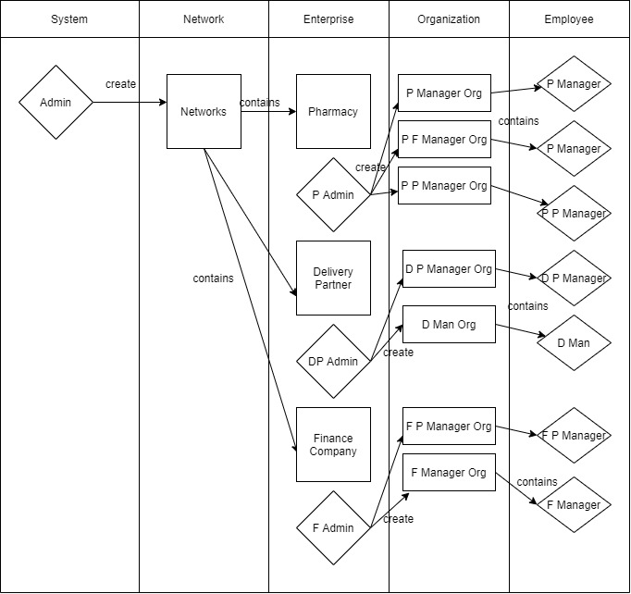
Manage Employee
Workflow

Slide 10
Create Enterprise

Slide 11


Slide 12
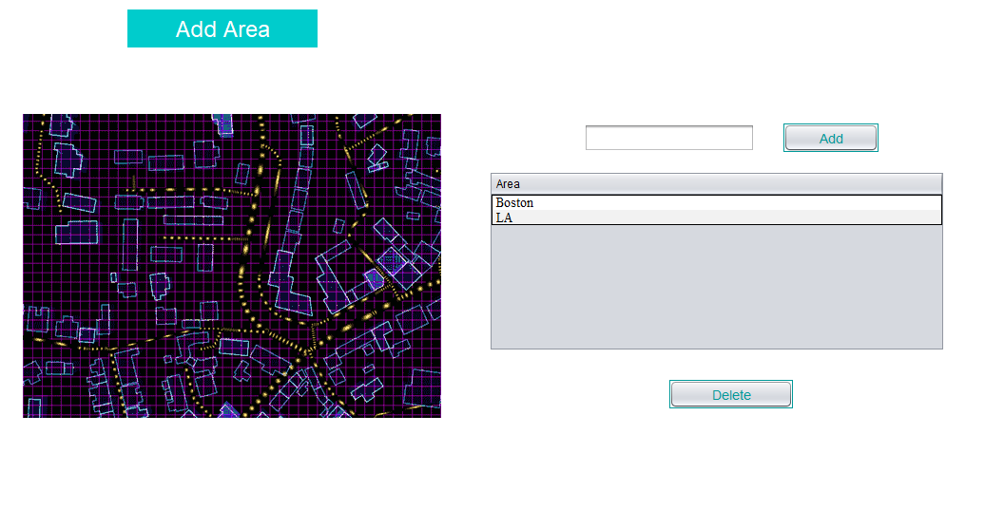

Slide 13
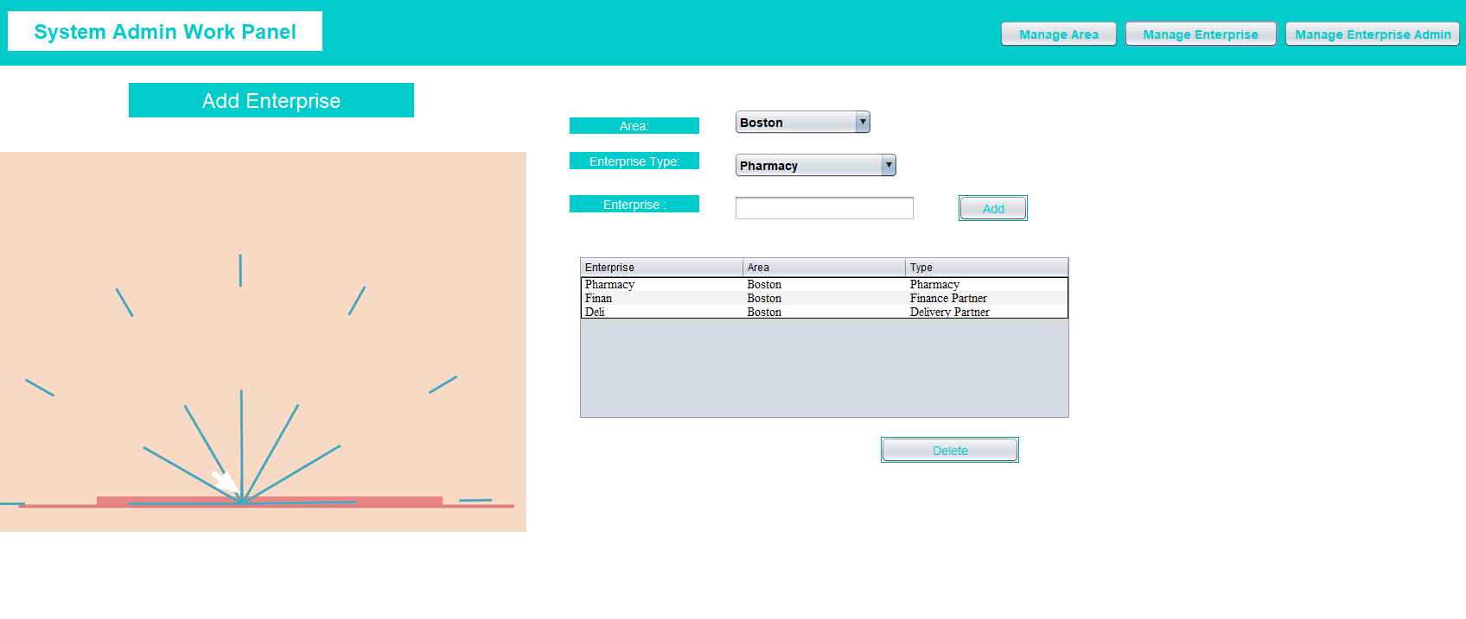

Slide 14
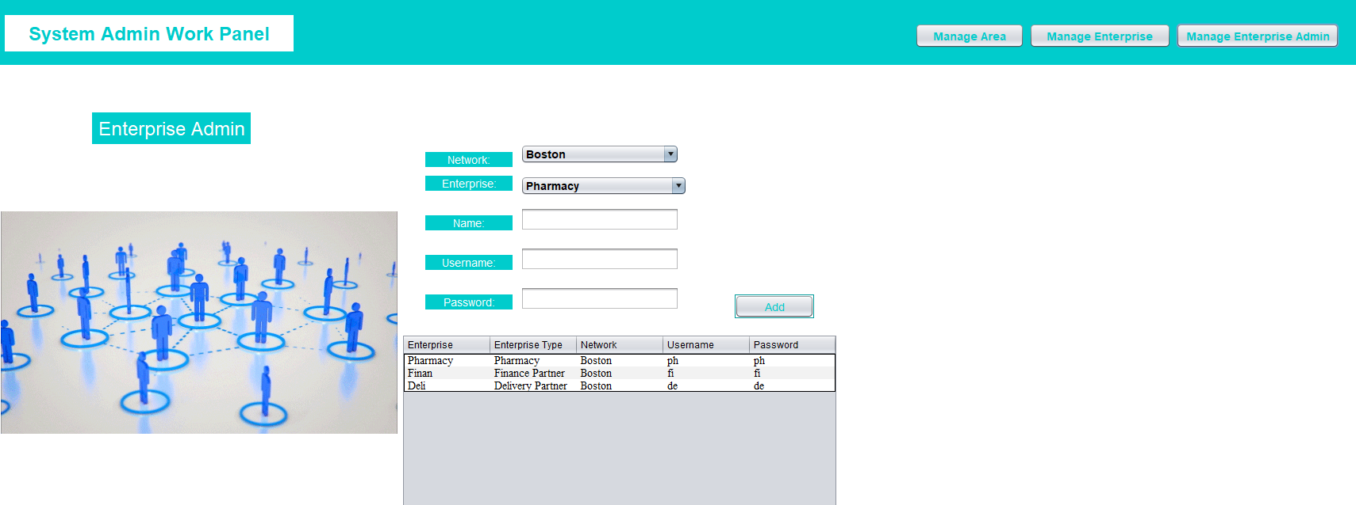

Slide 15
Create Employee/User

Slide 16
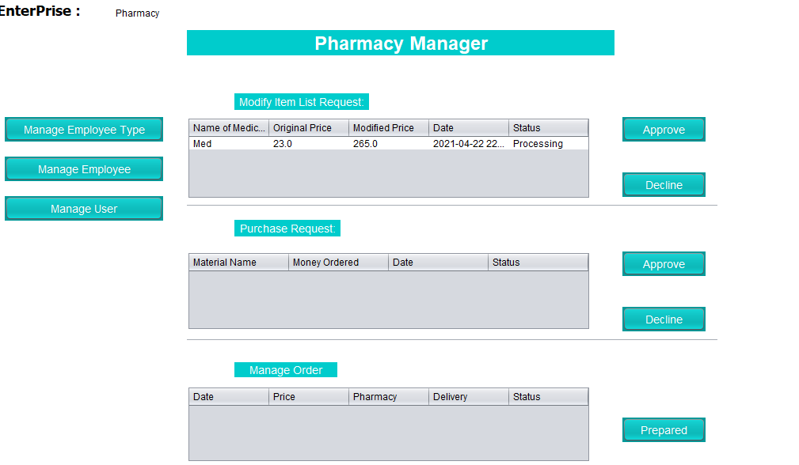

Slide 17
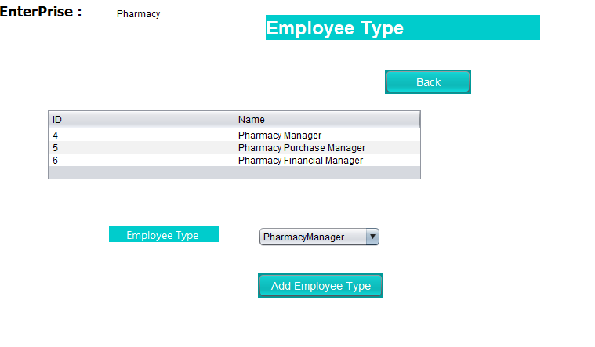

Slide 18
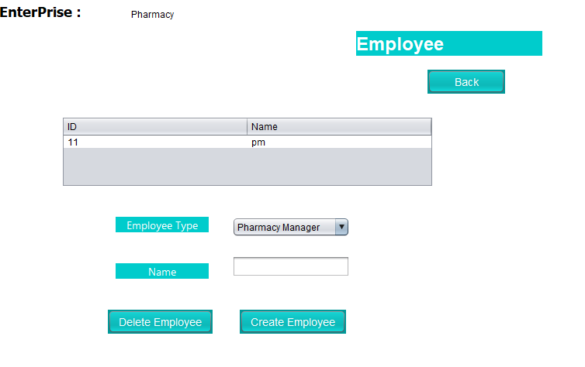

Slide 19
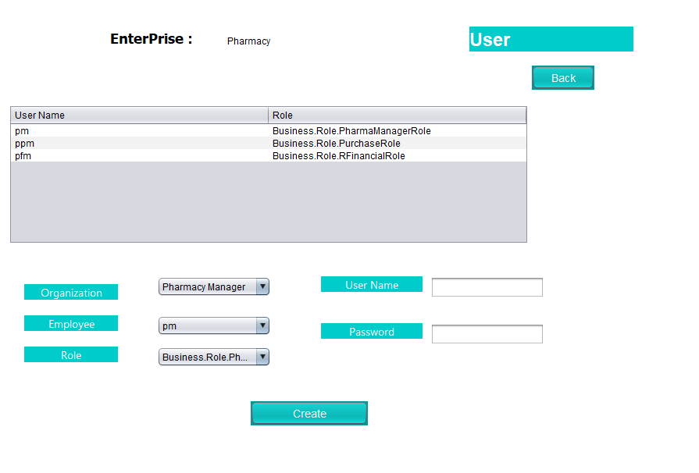

Slide 20
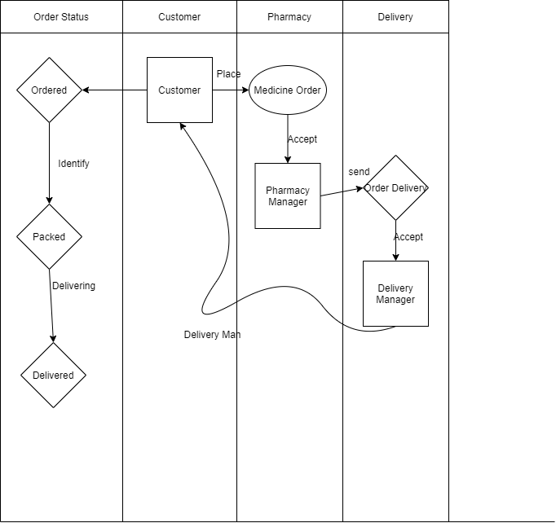
Order Medicine Workflow

Slide 21
CUSTOMER REGISTER

Slide 22
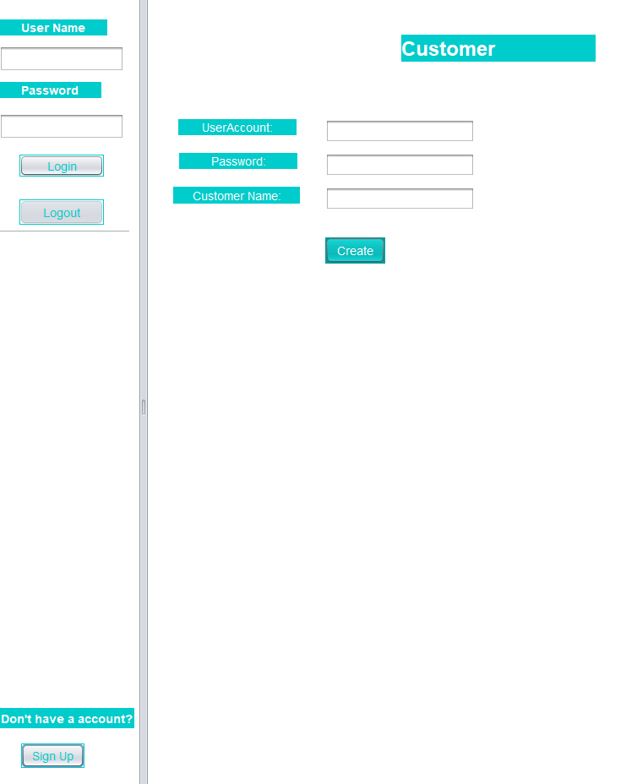

Slide 23
CUSTOMER ORDER

Slide 24
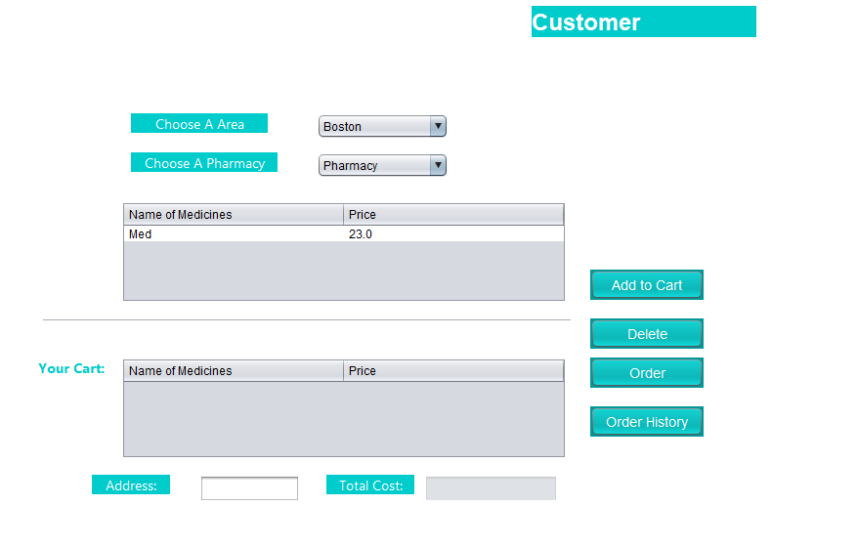

Slide 26
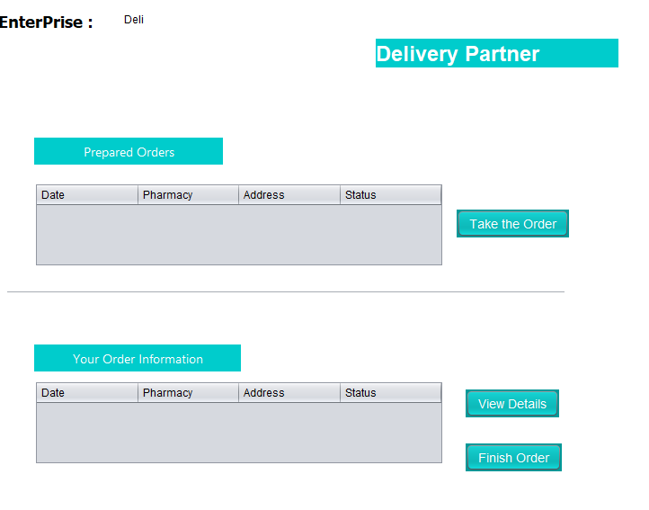

Slide 27
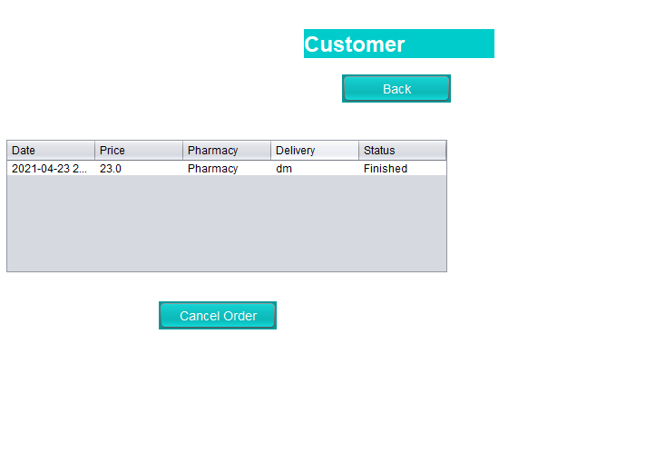

Slide 28
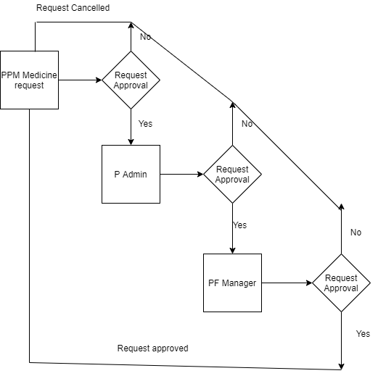
Medicine Purchase Request
Workflow

Slide 29
PURCHASE REQUEST

Slide 30
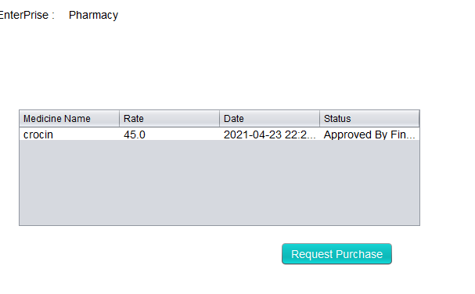

Slide 31
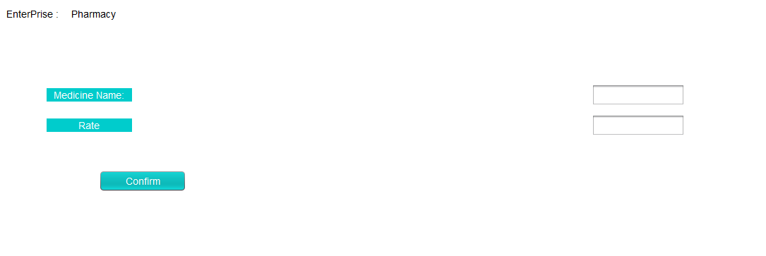

Slide 32
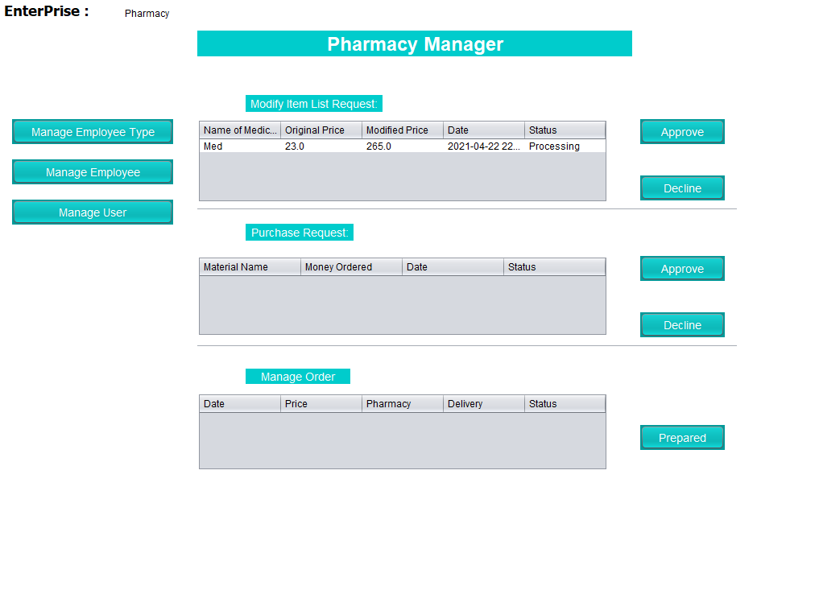

Slide 33
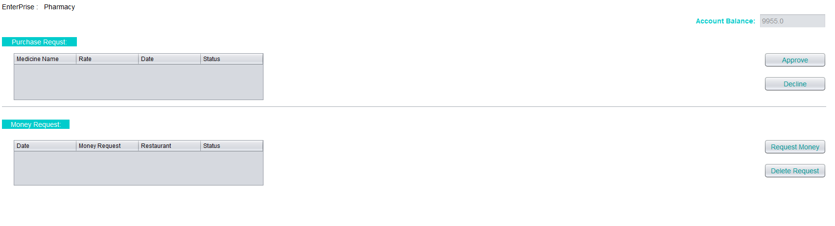

Slide 34


Conclusion:
The project has been successfully deployed.
Many needy people have been served at the right time.
Earned satisfaction of Delivery people.

